Slide 1


Mo’ Signal Mo’ Betta
MULTI-MICROPHONE DENOISING
Karl Ni
Notes:
Spread out microphones throughout the room
Isolate
Denoise

Slide 2
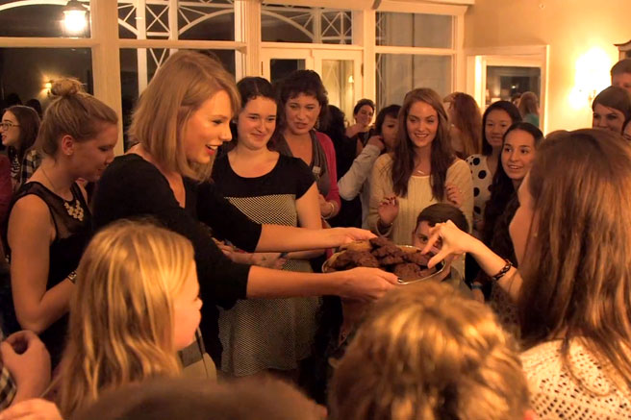
Notes:
Katie Perry had a mole in Taylor Swift’s entourage (since they have bad blood).
Somehow she knows that this person broke a vase at her party
Luckily before her party she threw a bunch of microphones around her room, though she was in a hurry.
Keypoint: distribute microphones arbitrarily.

Slide 3


Notes:
- Who broke your vase?

Slide 4






WHY SHOULD YOU CARE?
IMPACT AND COLLABORATION
OPERATIONAL
ECONOMIC
MISSION
INDUSTRY
ACADEMIA
Notes:
`Talked to PAG on a trip East
Mission: Get in, place sensors, and get out
Don’t want to calibrate, measure distances between mics, etc
Be safe, be quick
Ensure their safety while mission success
Talking to PAG and Dave G (after his meetings w/CIA+NSA); their mission = get in, place sensors, get out
Ensuring Safety and Mission Success
Impact
(Operational) PAG: Quick sensor placement & reliable data recovery
(Economic) Cheap COTS alternative that is simple and works
(Mission) Capability in enhances problems in other speech areas
(Community) Lab41 and IQT
MULTIPLE COMPANIES: Denoising from multimicrophone (Vesper).
Two companies. SetemTech
Not credible.

Slide 5
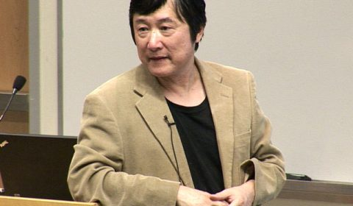

WHY THIS? WHY NOW?
STATE OF THE ART & RELATED WORK
Notes:
Speaker diarization through single microphone, not solved in over 20 years
Instead people opt for microphone arrays, highly calibrated
Would like spread out microphones for coverage, quick deployment, and easily hidden
Instead of signal processing techniques, use some deep learning that Li Deng promoItes

Slide 6
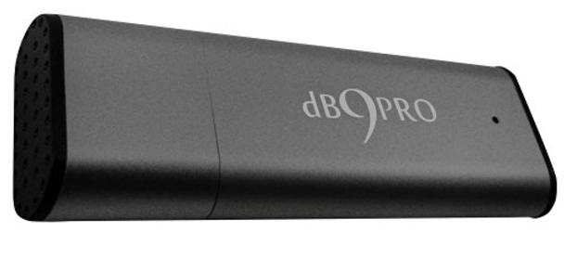
WHAT DO WE NEED?
SPECIFICS AND REQUIREMENTS
10 Amazon microphones $43.29. (Cheaper ones: $16.32)
Two FTE at 9 months
Travel costs
8 offsite campaign
Legal Advisement on Recording
Notes:
Timeline slide

Slide 7






EMAIL
kni@iqt.org
PHONE
650-690-5347
WEBSITE
www.lab41.org
BLOG
www.lab41.org/gab41
Notes:
Contact slide. Feel free to change to suit your needs

Slide 9
Intelligence Use Case
Urgency for this problem
Fast in Fast out
Attribution group (PAG)
Bonnie (Analyst) “Save lives and improves intelligence”
Coverage, expense, and placement

